Slide 1
Module VI
Deterministic safety assessment
Case Study (Exercise)
F. Adorján
HAEA (retired)
ferencadorjan@gmail.com

Slide 2
Learning objectives
To understand more deeply the significance and methodology of selecting the PIEs.
The exercise models the role of the safety analyst, but it is also important to understand by the regulatory reviewers.
The case is addressing the process of selecting the Postulated Initiating Events of LB LOCA type.
The main task is to find solid arguments for supporting the selection.
Notes:
Methodology
Presentation of the given case, situation, illustrations. (10 minutes max.)
Start plenary discussion, take note of the proposals, opinions. Give hints, whenever the discussion gets stuck or palls. (30 min)
Summarize the results of the discussion (5 minutes)

Slide 3
Case 1: Selection from the possible large break cases – LB LOCA variations
The position of the break (200 percent, guillotine):
  cold leg – hot leg - syphon;
  close to the RPV, close to SG, relative to the ECCS junction, relative to the MCP, relative to the pressurizer, etc.
Operational mode, initial status of the reactor:
  full power, low power, zero power, critical, sub-critical;
  if sub-critical, then nominal pressure/temperature, or cool down, heat-up phase;
  BOC, EOC, or some specific phase in the fuel cycle;
Notes:
LB – large break
LOCA – loss of coolant accident
RPV – reactor pressure vessel
SG – steam generator
ECCS – Emergency core cooling system
MCP – main circulation pump
BOC – beginning of cycle
EOC – end of cycle

Slide 4
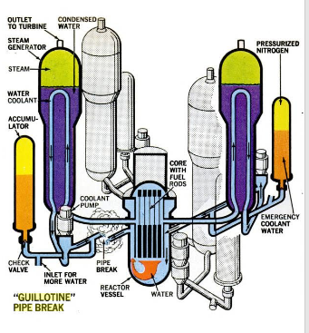
200 percent guillotine break
A four loop PWR primary circuit with some elements of the ECCS (hydro-accumulators)
Notes:
This picture is not showing the pressurizer and only the passive elements of ECCS are visualized (hydroaccumulators).
Hint: the real structure of the primary system with the ECCS components is much more complicated.

Slide 5
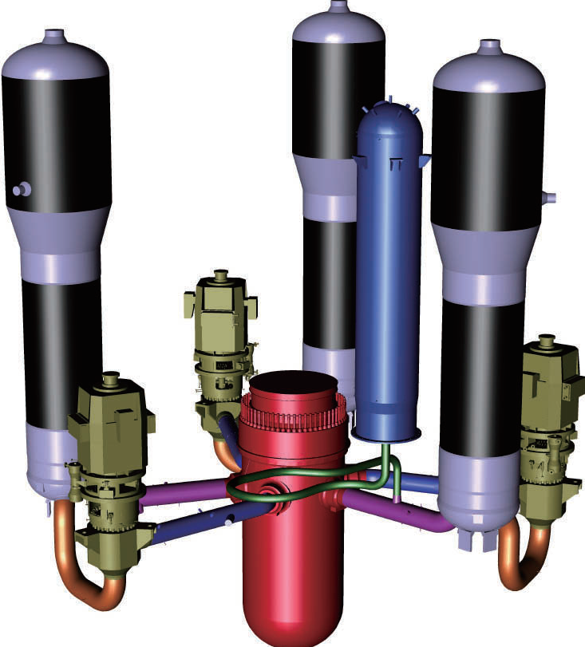
A typical PWR primary system
The geometry is more accurate here. Note that this is a three loops reactor.
The pressurizer is displayed here, bot no components of the ECCS are presented.
Notes:
The junctions of the ECCS to the main circulation pipelines (with typical diameter of 600-800 mm) are shown.
In some designs the junctions of the cold leg and the hot leg to the RPV are below each other.
The exact location of the break has only minor effect on the scenario. The main effect is on the selection of the section: cold leg (blue), hot leg (purple), syphon (brass). The selection of the loop connected to the pressurizer also makes difference. Most important is whether there is an ECCS junction on the broken loop or not.

Slide 6
Selection from large number of possible cases the PIEs to analyze
The analysis of each cases requires a few man-months effort
Use engineering judgement for selecting the worst cases. Hints:
  depending on the position of the break, some of the ECCS components become ineffective
  the hydraulic resistance may play some role
  at low power the negative feed-back mechanisms are weaker
  at EOC the residual heat is higher
You have to find strong arguments to support your selection!
  The correct selection depends on the details of the design!

Slide 7
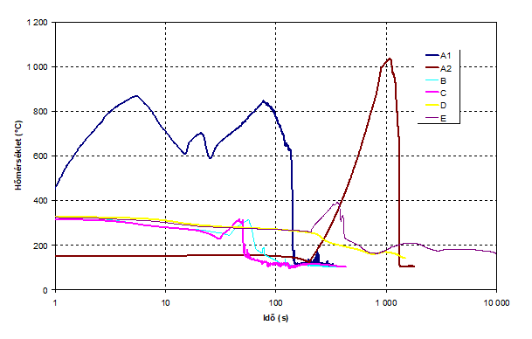
A real example (from the Paks plant analyses)
Peak cladding temperature
6 LB LOCA cases
A1: full power, cold leg with no pressurizer on the loop
A2: in cool down phase, the same cold leg, just after disconnecting the ECCS
This is counter intuitive case!
Notes:
In the A2 case, in spite that the break supposed to be occurring 4 hours after shutting down the reactor resulted in the least margin (the criterion is 1200 Celsius) due to the correct assumption of the “15 minutes rule”, i.e. no operator action is to be assumed after the PIE within 15 minutes (900 seconds) in the analyses. Since in this case the PIE occurred after disconnecting the components of the ECCS according to the procedures for cooling down the reactor, no automatic ECCS intervention could occur. Clearly, the timely operator action is indispensable in this case.
Note, that for modern plants, instead of “15 minutes rule” the “30 minutes rule” is applied.

Slide 8
The task
Assumed configuration:
  a 3 loop plant;
  the pressurizer is connecting to loop 1;
  four-fold ECCS redundancy (2 are connected to the cold legs of loops 2 and 3, respectively and 2 are connected directly to the RPV) and 2 out of 4 ECCSs are sufficient;
  consider 3 sections of each loop (hot leg, cold leg, syphon);
  assume 3 different plant initial operating modes: full power, low power cool-down phase;
  all-together 27 possible cases + the actual ECCS configuration.
The goal is to select the 4 (or max 6) PIE cases to bound all the rest and elaborate strong arguments to support your selection.
Notes:
The task is to be completed in 20 minutes by a plenary discussion, brain storming.
ECCS configuration: one of the redundant ECCSs is supposed to be out of service (e.g. due to maintenance).
Hints for the selection (not to be given to the participants in advance):
loops 2 & 3 are symmetrical, it’s enough to analyze only one of them,
the 2 ECCSs connecting to the RPV are also symmetrical,
if the break is in loop 1, no ECCS is lost due to the break, but the coolant inventory of the pressurizer is lost, therefore these cases may be bounded by the breaks of loop 2 (3),
the reactivity feedback plays no role in this accident, thus the low power case is bounded by the full power case;
the loss of pressurizer inventory for the cool-down phase break may play a significant role;
as the ECCS is connected to the cold leg, the cold leg break bounds both the break at the syphon or at the hot leg, because in the latter cases only some part of the ECCS feed is lost.

Slide 9
Summary
Were the objectives reached?
Could we find solid arguments to support our selection?
Why could it be useful for regulatory reviewers also?
Was the exercise useful at all?

Slide 10
Thank you for your co-operation!
Notes:
Thank you!

